Slide 1
Dewar Communication Cable Part 3

Slide 2
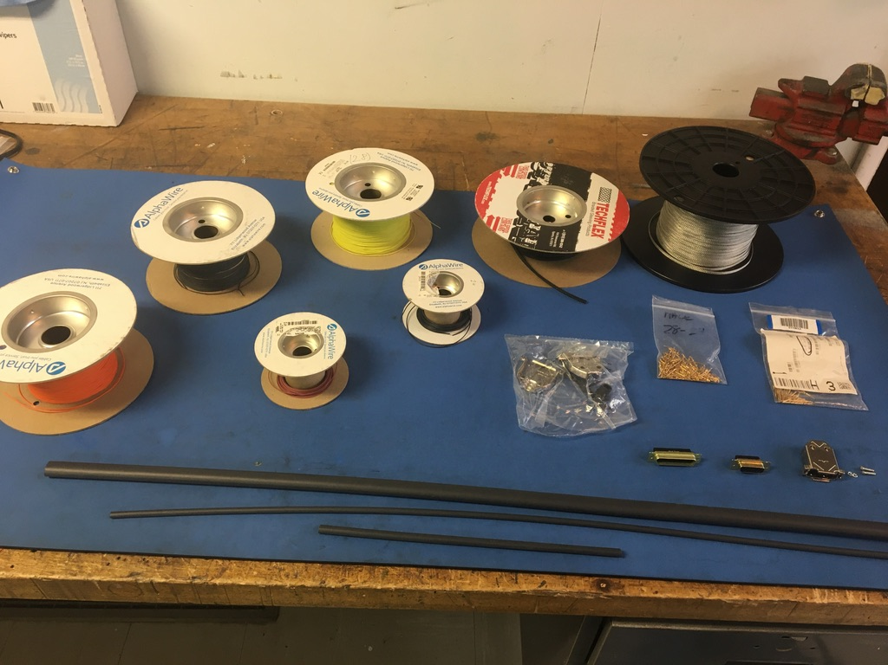
Materials

Slide 3
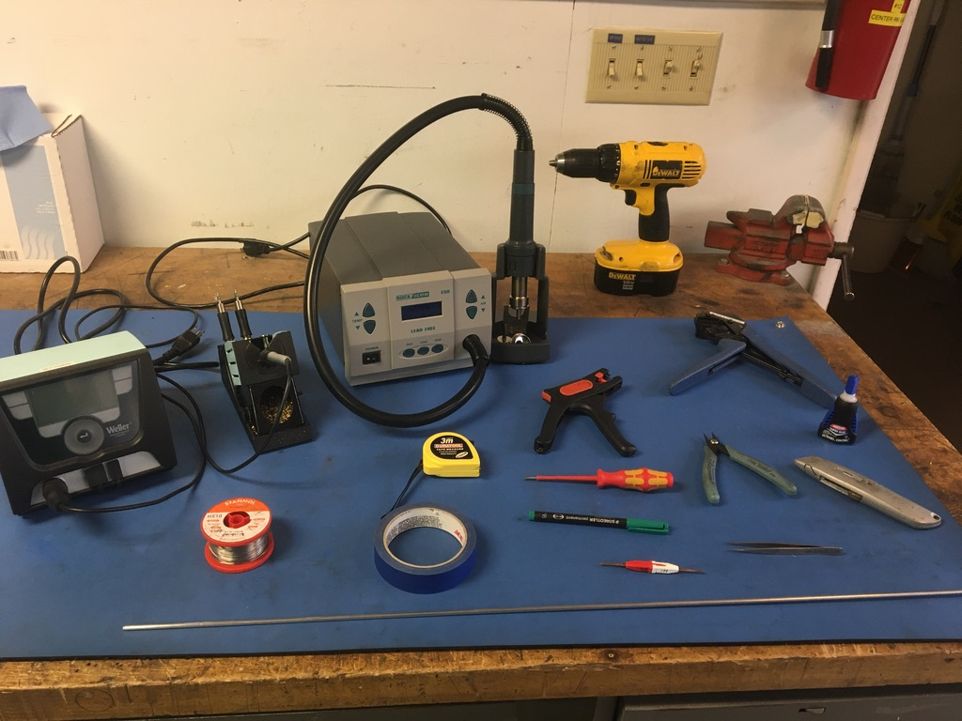
Tools

Slide 4
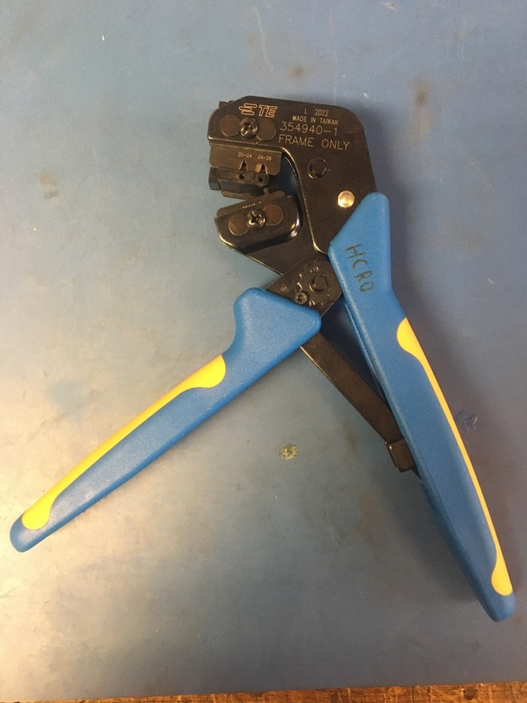
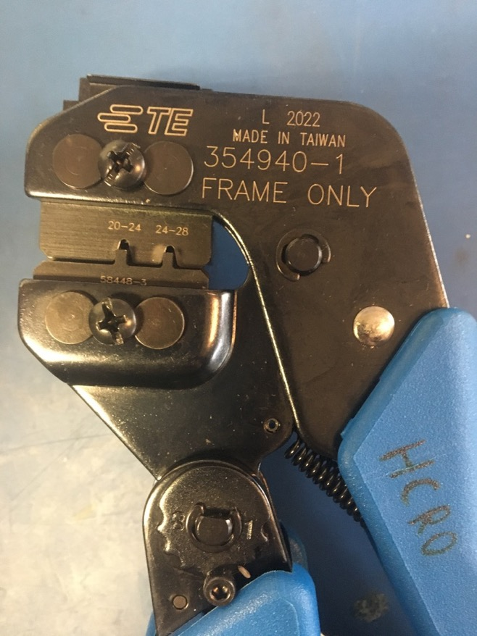
D sub Crimp Tool

Slide 5
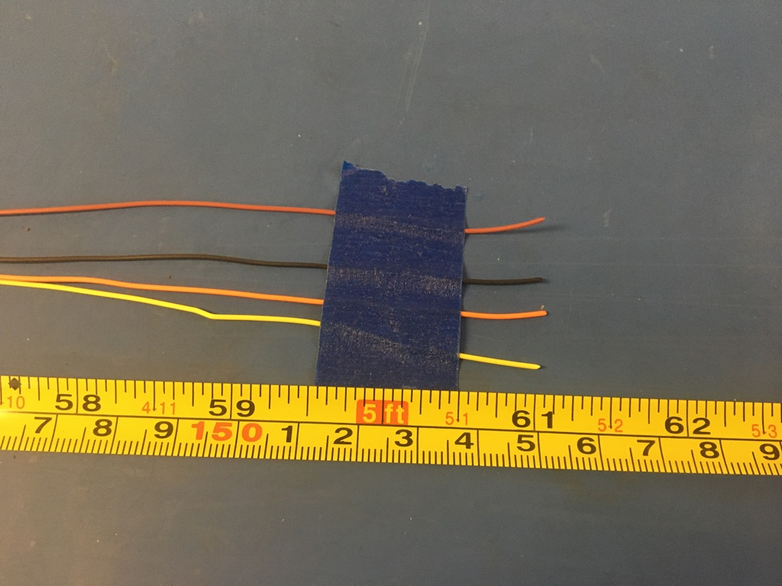
Measure out and cut two lengths of brown, black, orange, and yellow 28 awg wire each 61 inches long.

Slide 6
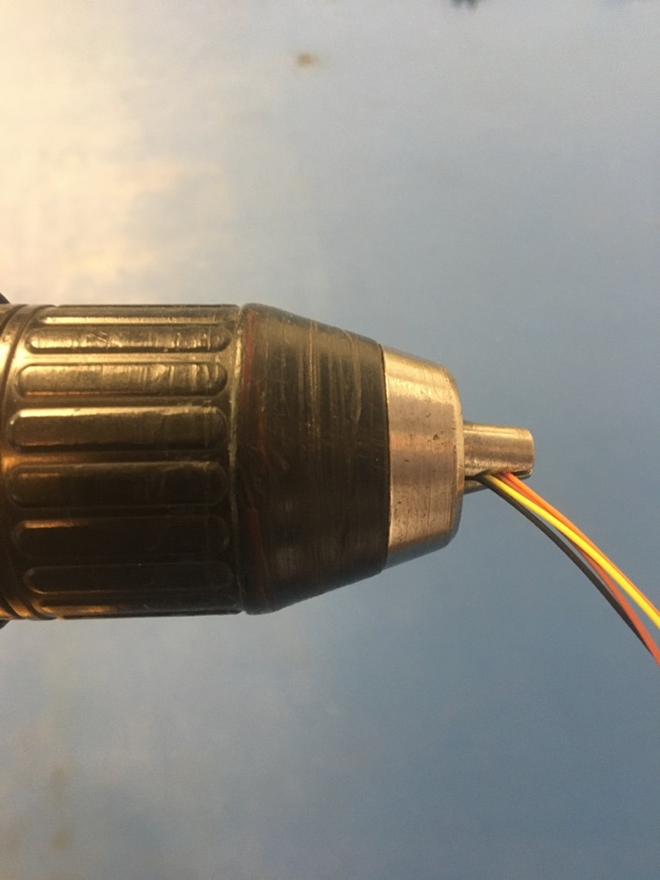
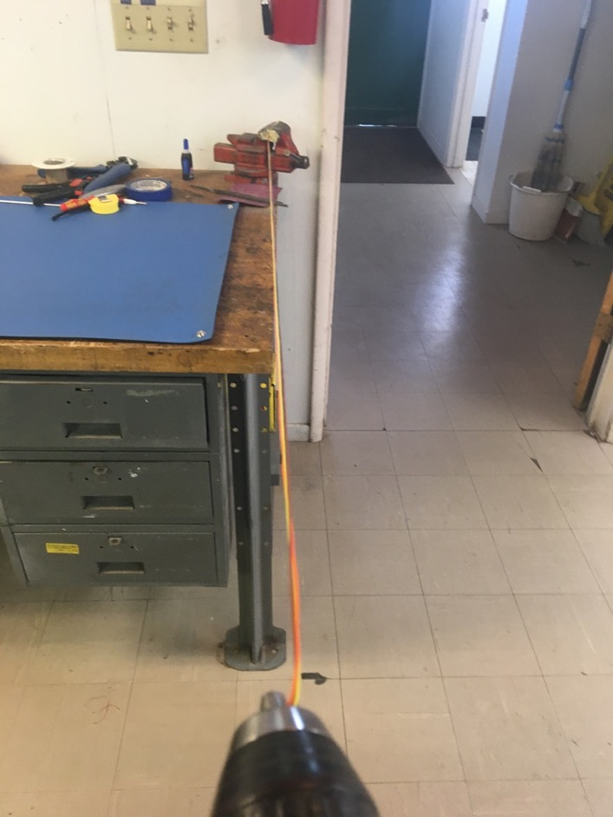
To make the twisted quadruples, line the vise with masking tape. Put one end of the brown, black, orange, and yellow wires into the drill. Run the drill till the wires are sufficiently twisted (for reference see the next slide). Repeat with the second lengths of the same color wire.

Slide 7
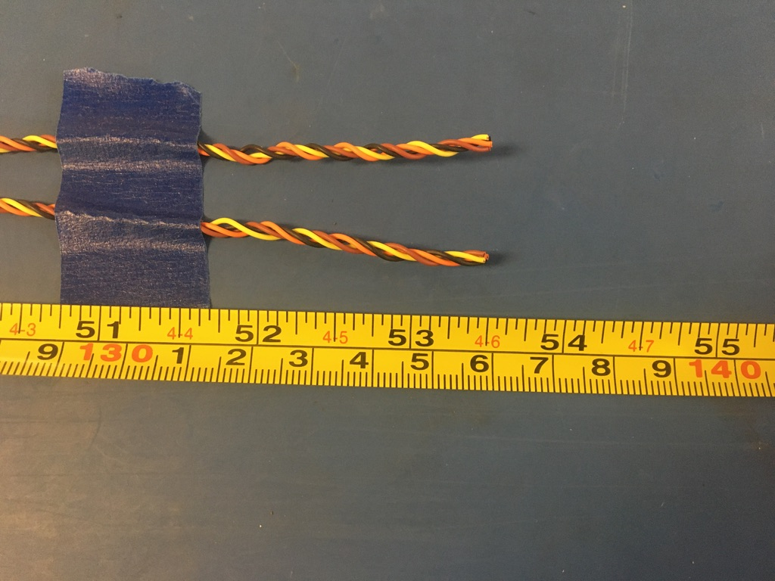
Trim the ends of each twisted quadruple where they were in the vise and drill. Once trimmed they should measure about 53.5 inches.

Slide 8
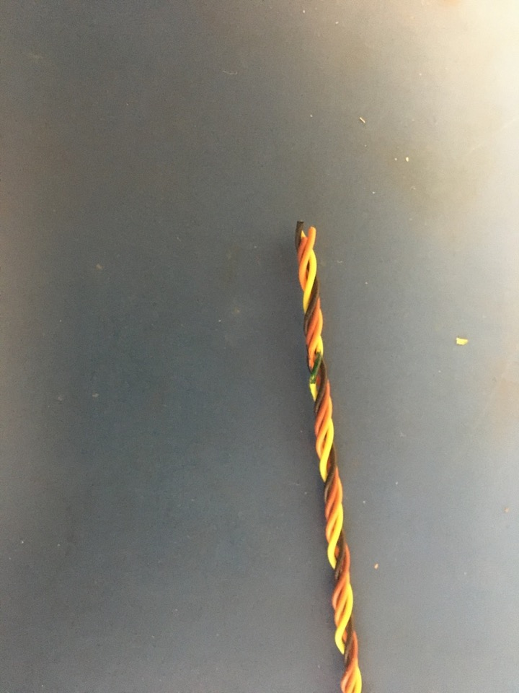
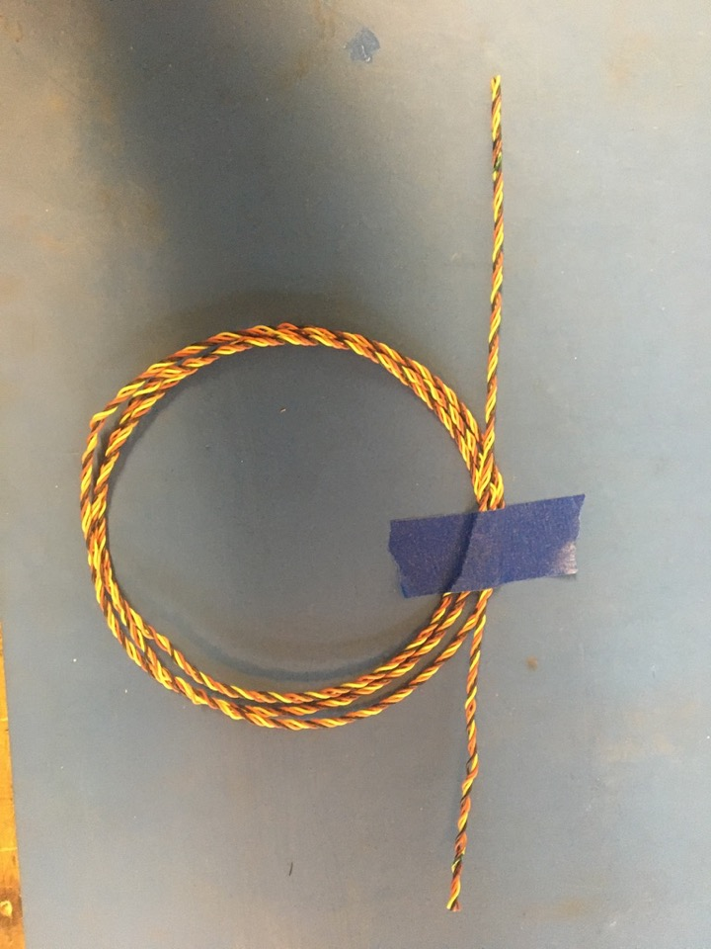
Using a permanent marker, mark each end of one of the twisted quadruples. This will be important for connector positions later since the two twisted quadruples are otherwise identical.

Slide 9
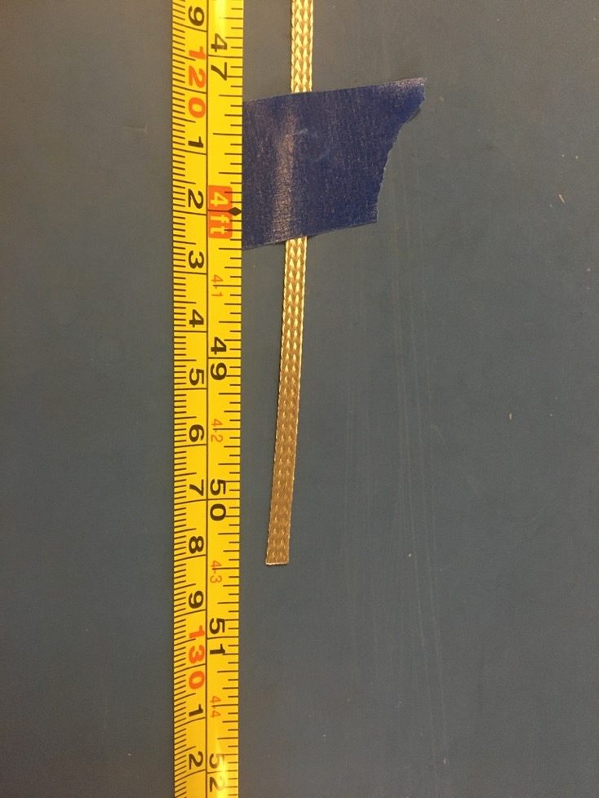
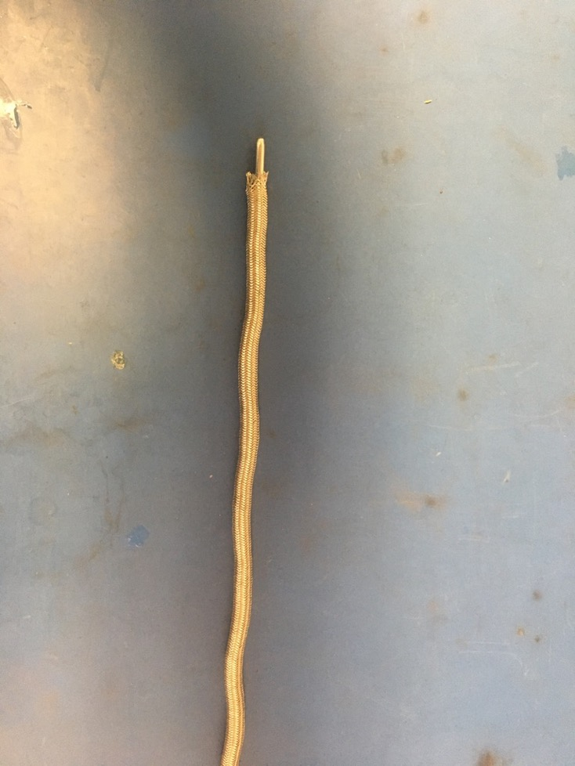
Measure out 50.5 inches of the 1/8th metal braid. Expand it using the metal rod.

Slide 10
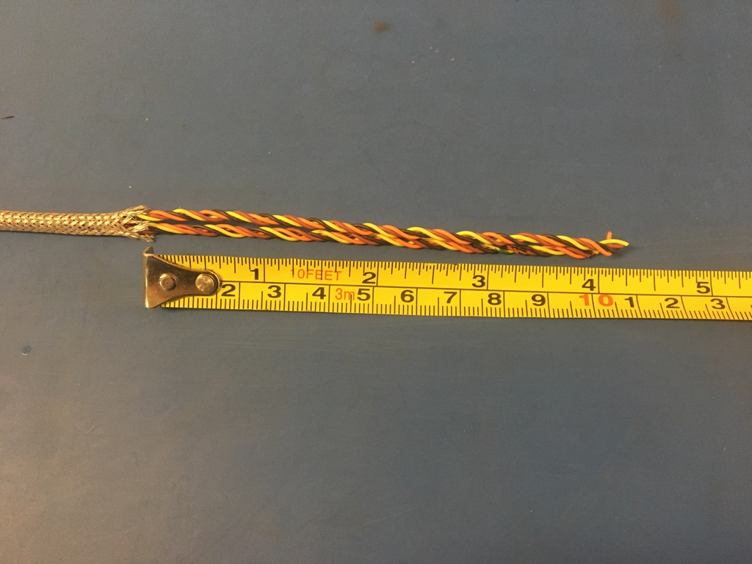
Put the twisted wires into the expanded metal braid. 4 inches of the twisted wires should stick out from the metal braid on one end.

Slide 11
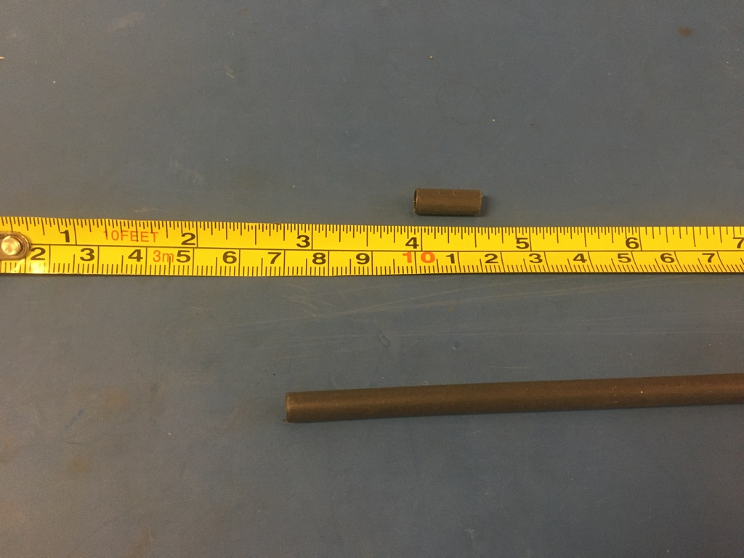
Measure out and cut two lengths of 4.8mm adhesive shrink tube each .5in long.

Slide 12
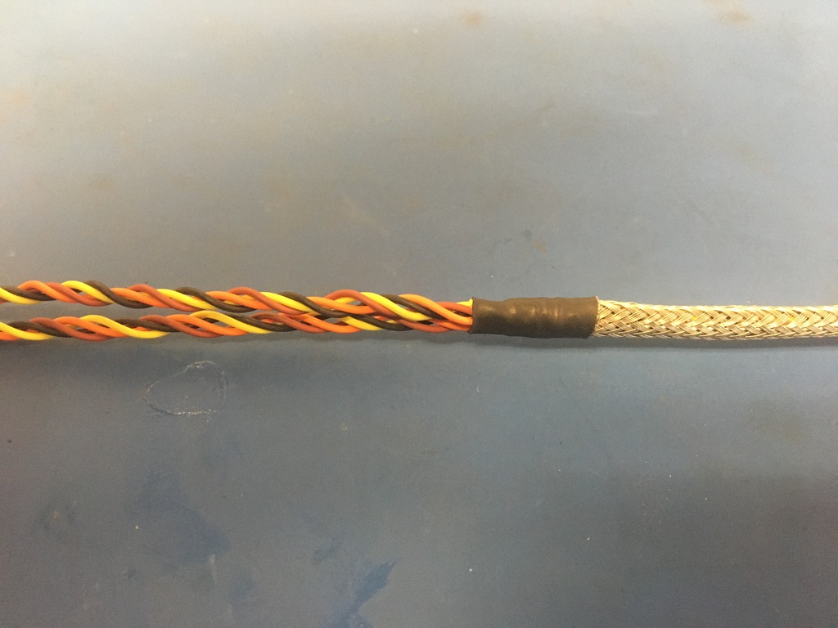
Put one of the pieces of the shrink tube onto the end of the metal braid where the wires measured 4 inches. Place the shrink tube such that the metal braid ends midway through it. The wires should now measure 3.75 inches long. Apply the heat gun to the shrink tube.

Slide 13
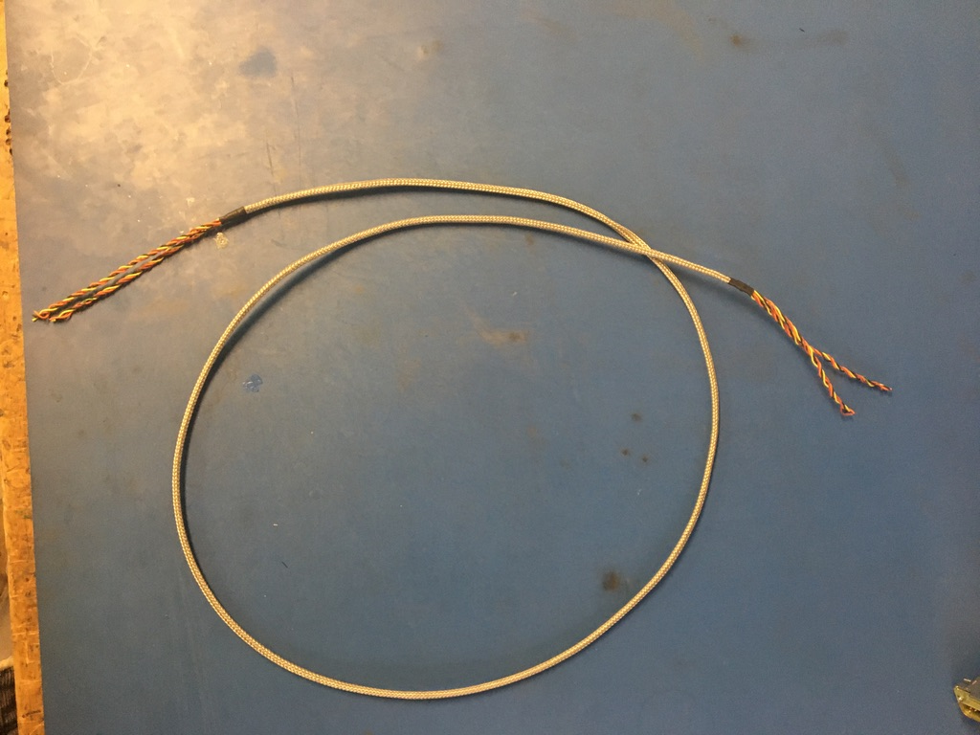
Repeat the process on the previous slide on the other end of the metal braid (though the wire does not need to be measured this time). Thus far, the wire harness should appear as shown below.

Slide 14
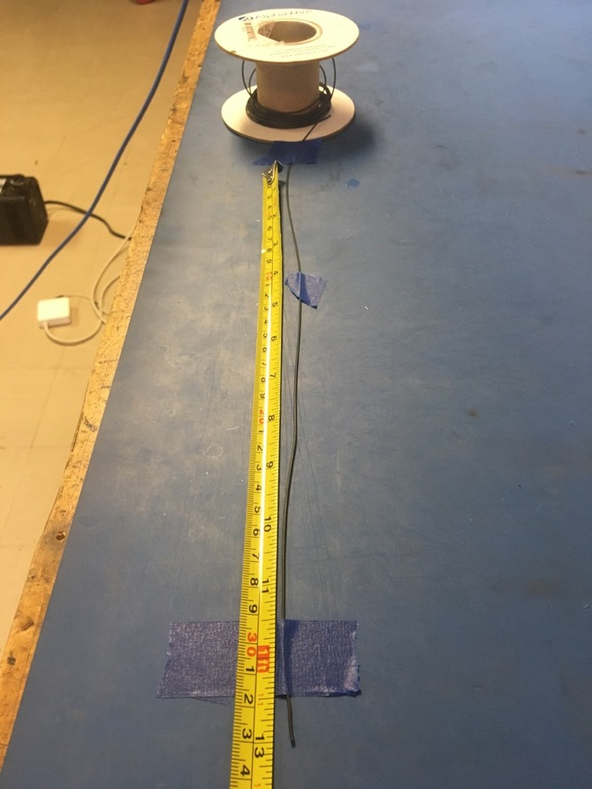
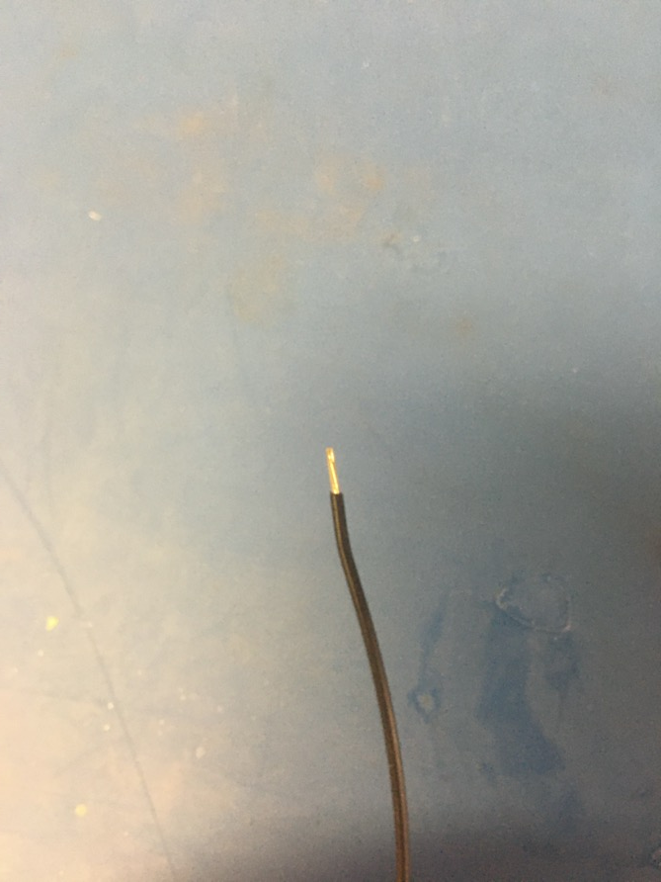
Measure out and cut 13 inches of black 24 awg wires. Strip 3-4mm off one end.

Slide 15
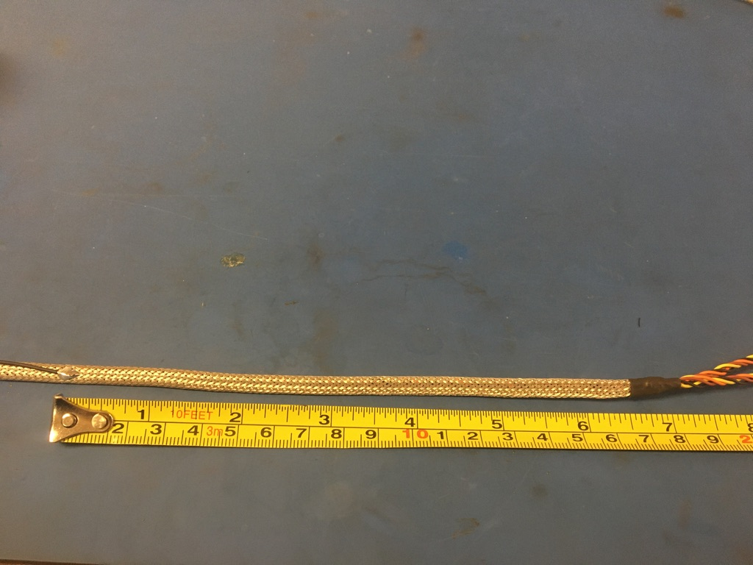
Solder the stripped end of the black wire onto the metal braid 6.5 inches from the shrink tube joint of the end of the harness with the shorter twisted wires (the end that was not measured). The black wire should be soldered so the that its length runs with that of the metal braid.

Slide 16
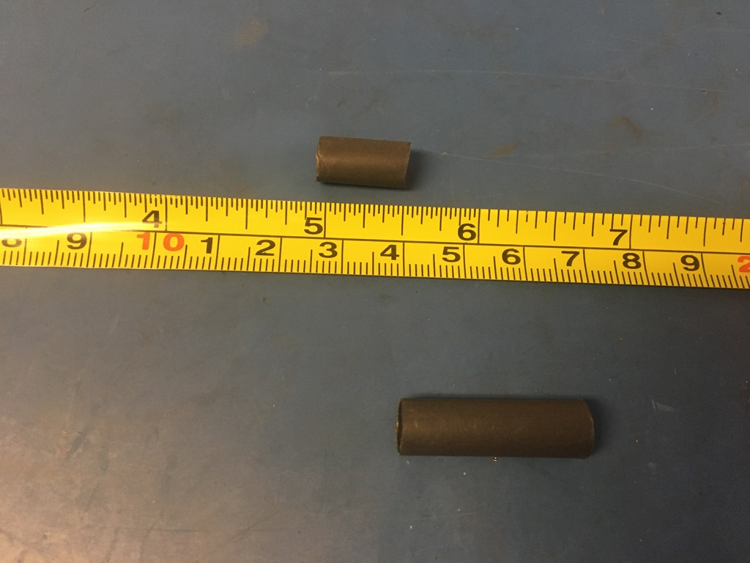
Measure out and cut one length of 6.4mm adhesive shrink tube that is .5in long.

Slide 17
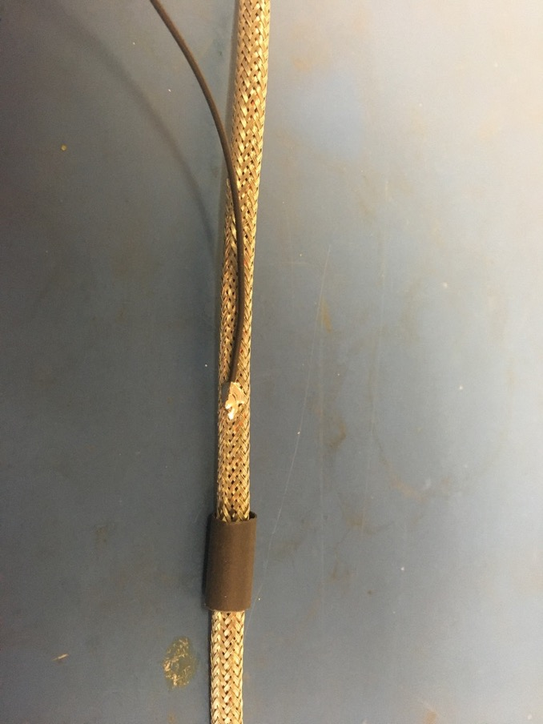
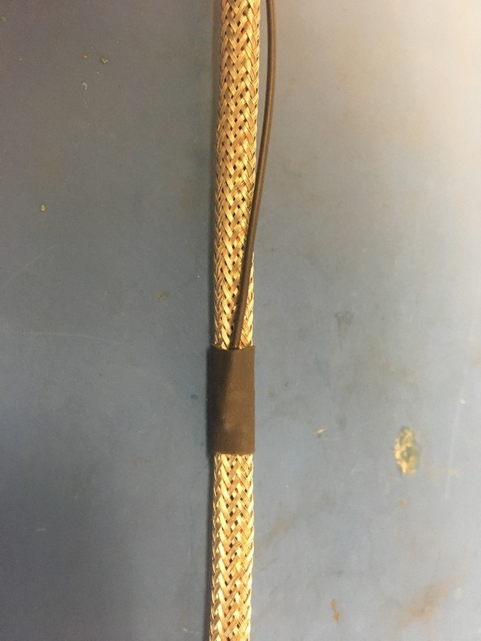
Put the piece of shrink tube onto the harness and over the black wire’s solder joint. Apply the heat gun.

Slide 18
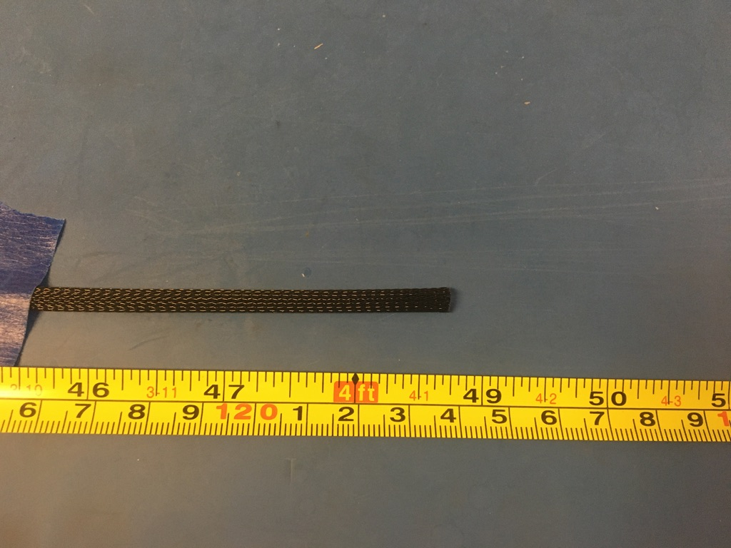
Measure out and cut 48.75 inches of 1/4th plastic braid.

Slide 19
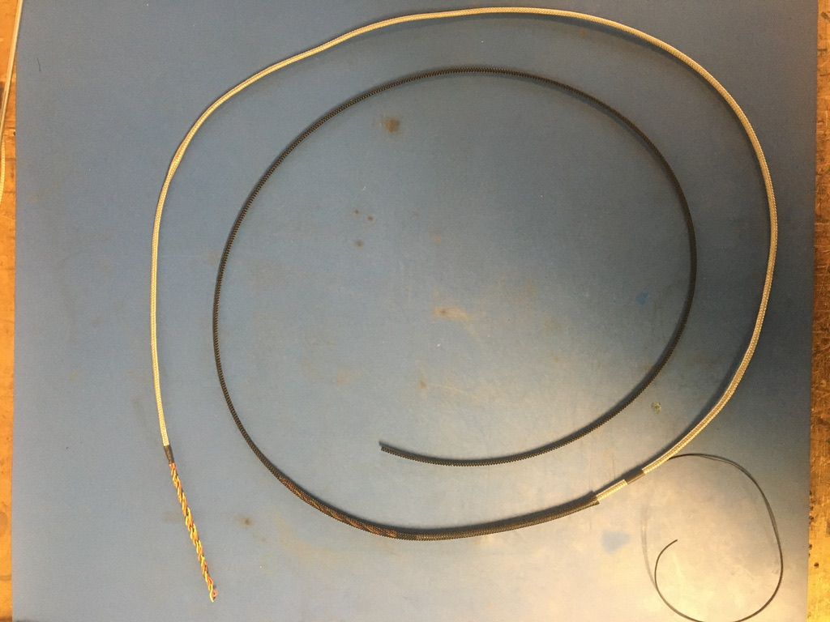
Put the plastic braid onto the wire harness from the end closest to the ground wire.

Slide 20
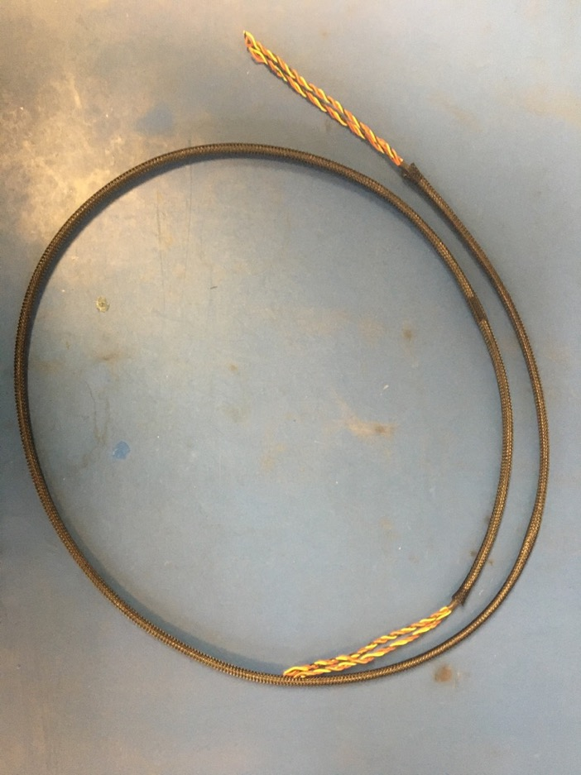
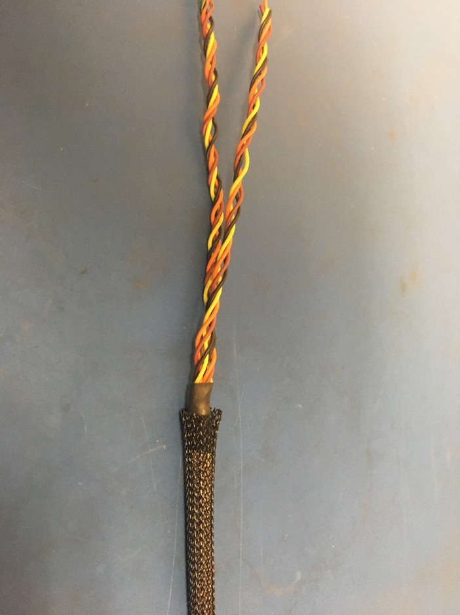
At each end of the harness, the plastic braid should end midway through the metal shrink tube joints.

Slide 21
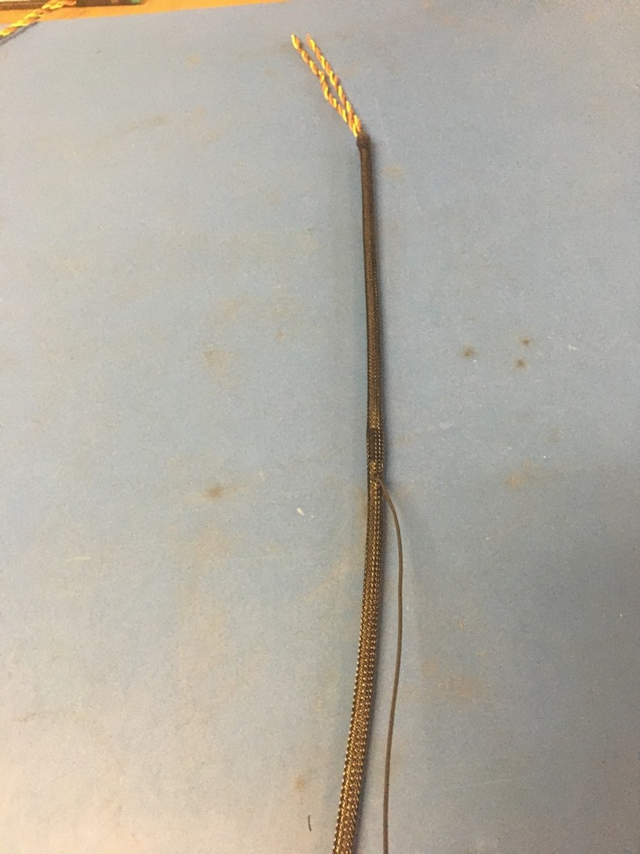
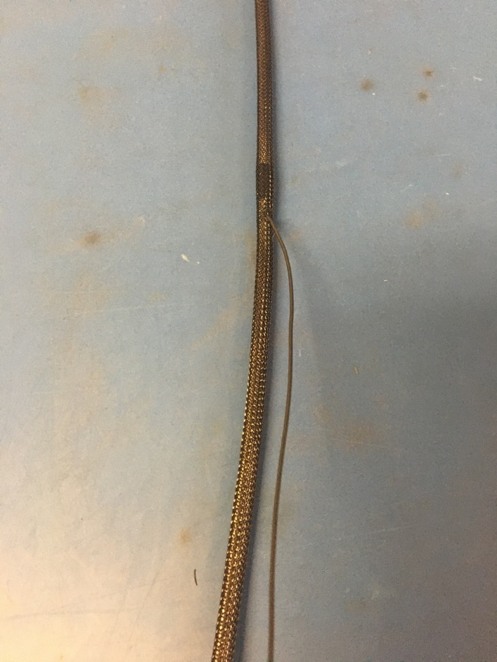
Thread the ground wire through one of the holes in the plastic braid so it appears as shown. Use the tweezers if needed.

Slide 22
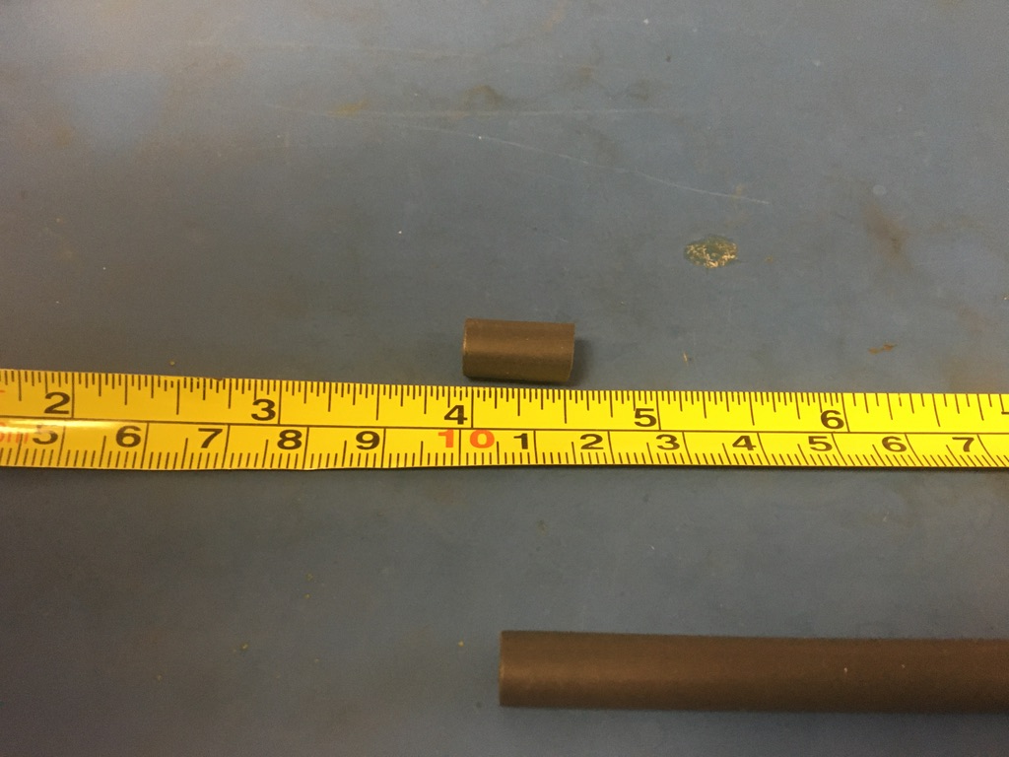
Measure out and cut two lengths of 6.4mm adhesive shrink tube that are each .5in long.

Slide 23
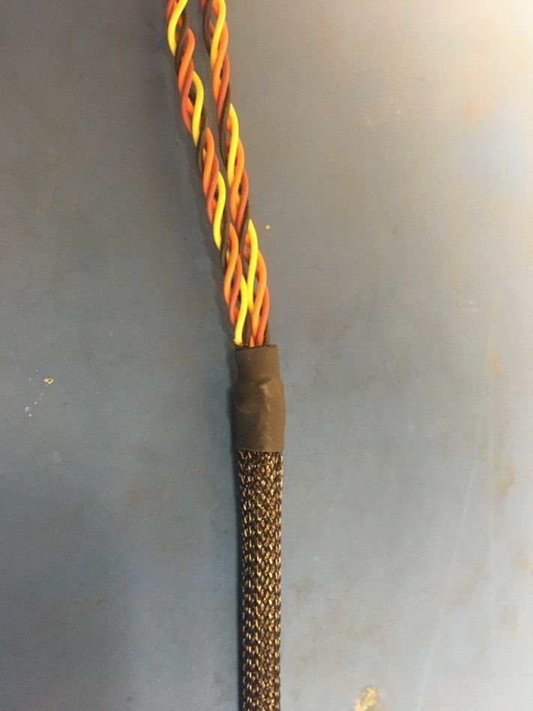
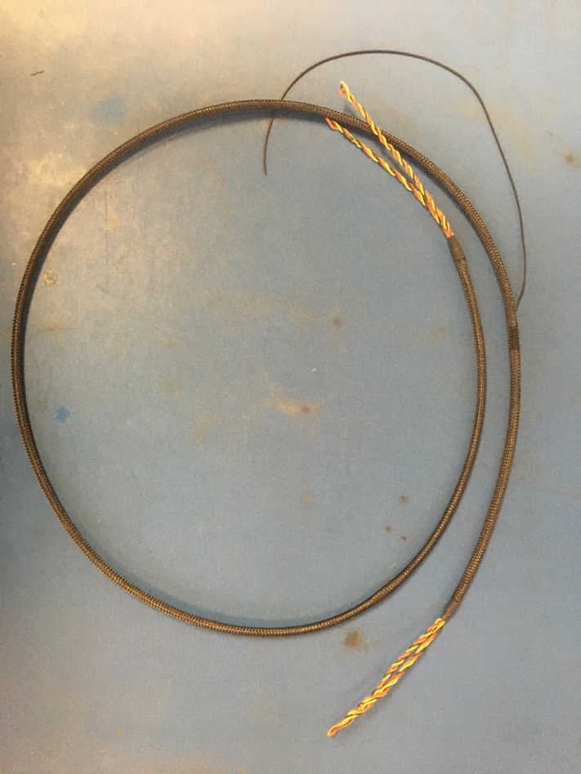
Place the pieces of shrink tube onto the plastic braid ends. The plastic braid should end midway through each piece of shrink tube. Apply the heat gun. Thus far, the wire harness should appear as shown on the right.

Slide 24
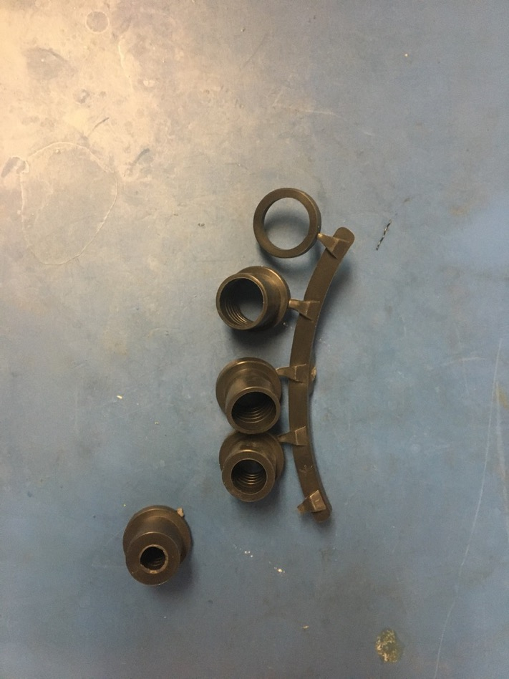
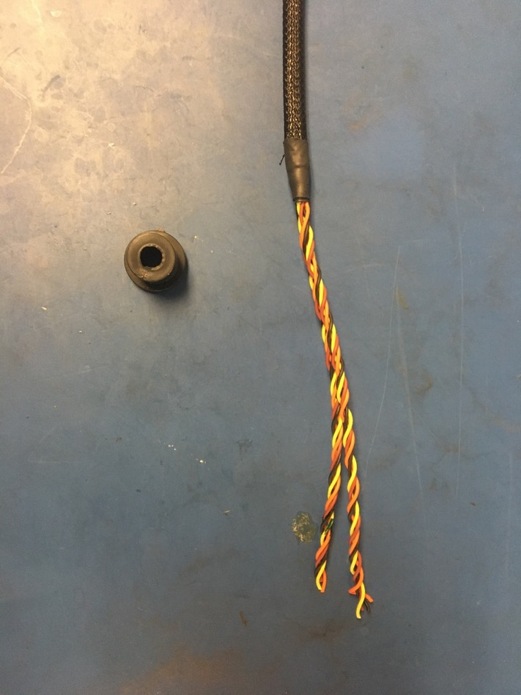
Select the 25 pin D-sub shell stop. If using a new 25 pin D-sub shell, the smallest size is appropriate. However, if reusing an old 25 pin D-sub shell, use the smallest size available. Test the 25 pin D-sub shell stop on the end furthest from the ground wire. If the fit is loose, layer shrink tube until the fit is more snug.

Slide 25
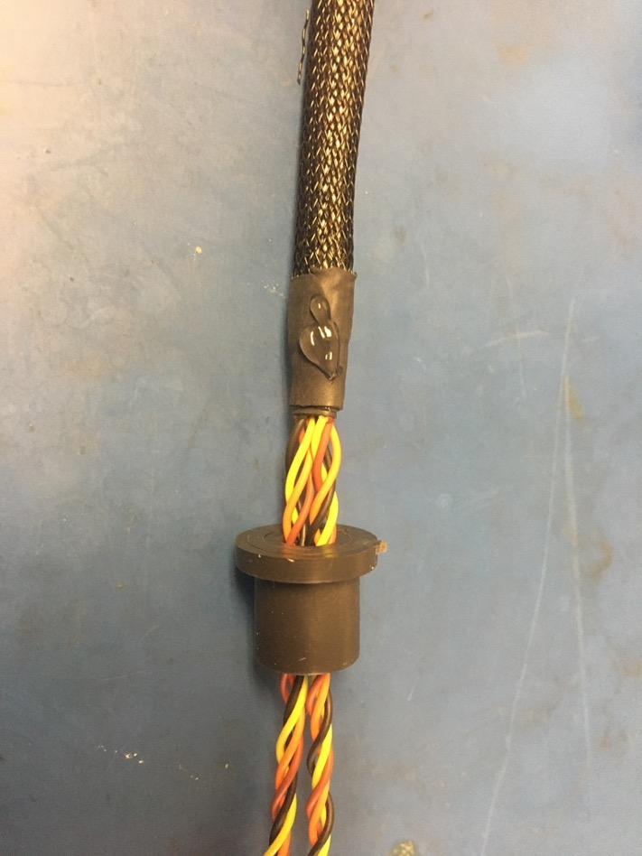
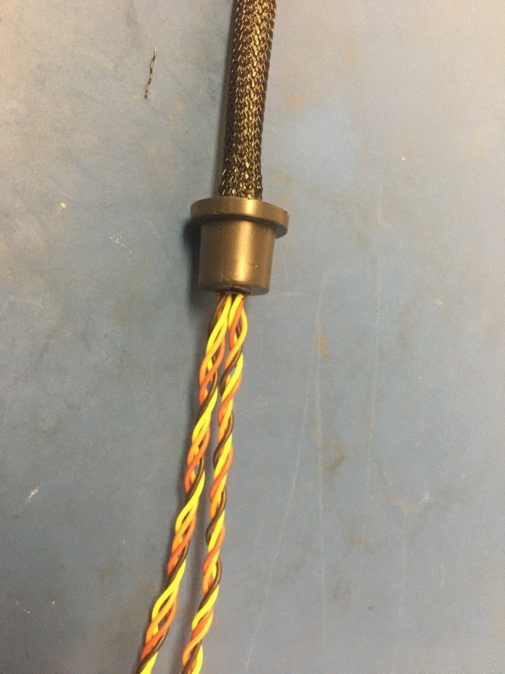
Once any additional shrink tube is added, thread the D-sub shell stop onto the end furthest from the ground wire and apply super glue to the end of the shrink tube as shown. Put the D-sub shell stop over the super glue and twist it around to spread the super glue inside the stop. The final position of the D-sub shell stop is as shown on the right: with the stop’s end flush with that of the shrink tube.

Slide 26
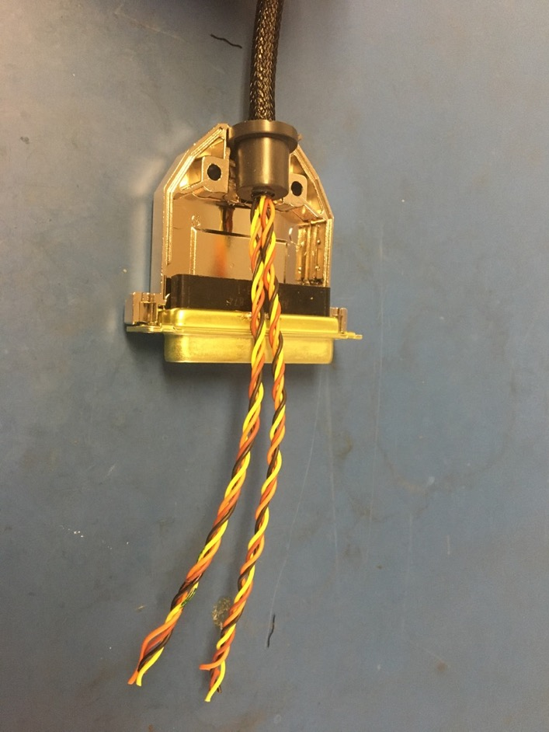
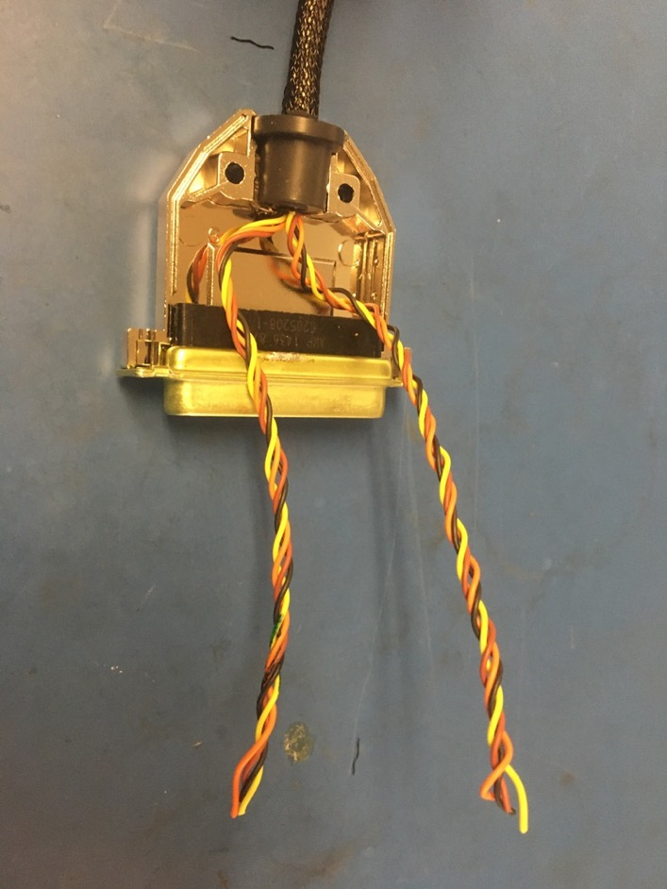
Place the D-sub shell stop into the bottom of the 25 pin D-sub shell as shown. Put the 25 pin male D-sub connector into the bottom of the shell as well. Position the wires as shown on the right. The marked quadruple should be on the right. Furthermore, mark the marked quadruple again but close to the D-sub stop (elsewise the marking will be trimmed off).

Slide 27
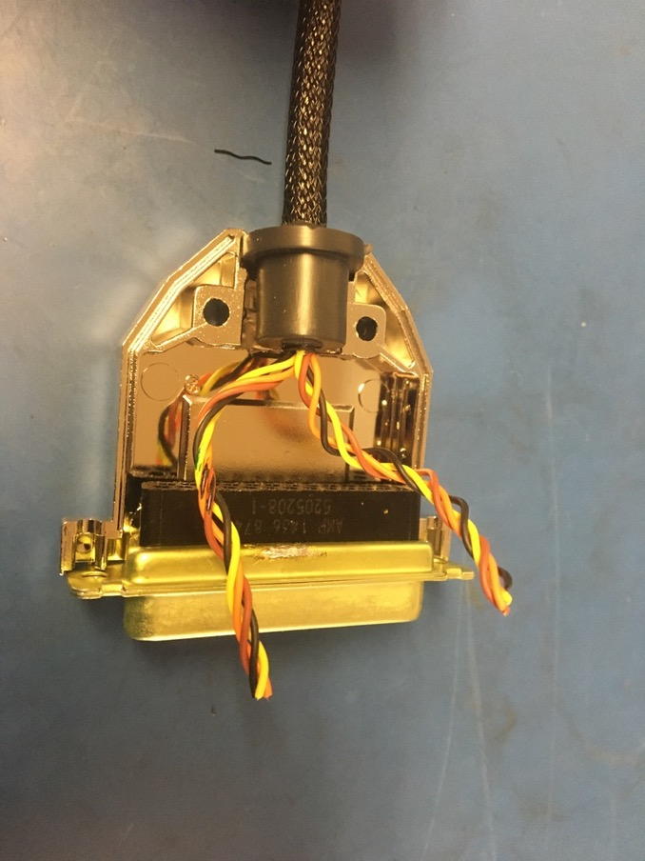
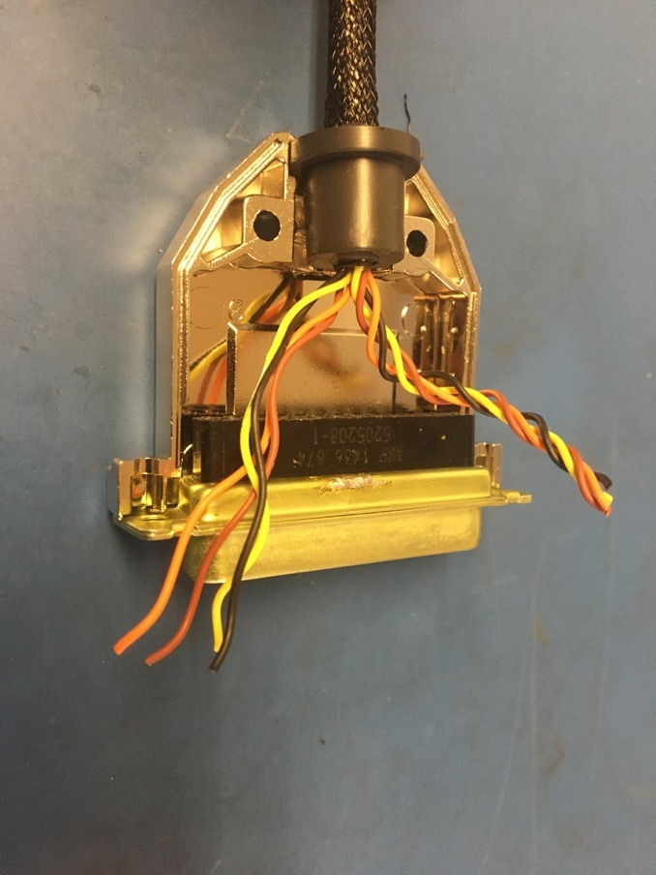
Measure out and cut the twisted pairs so that they end at the mouth of the connector. Untwist and straighten the marked quadruple .

Slide 28
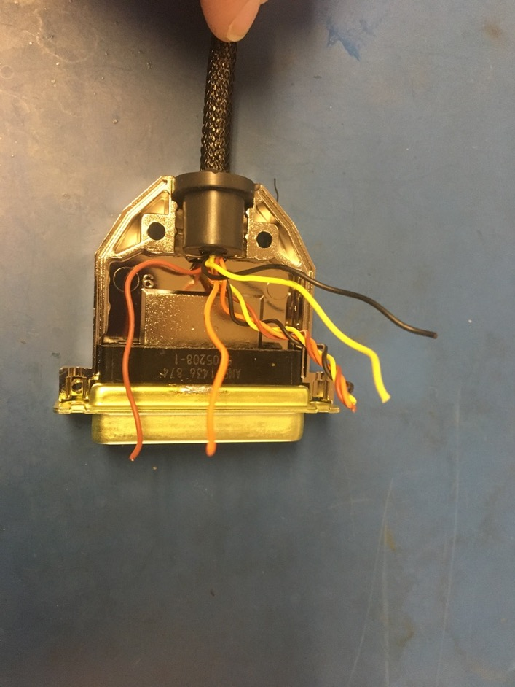
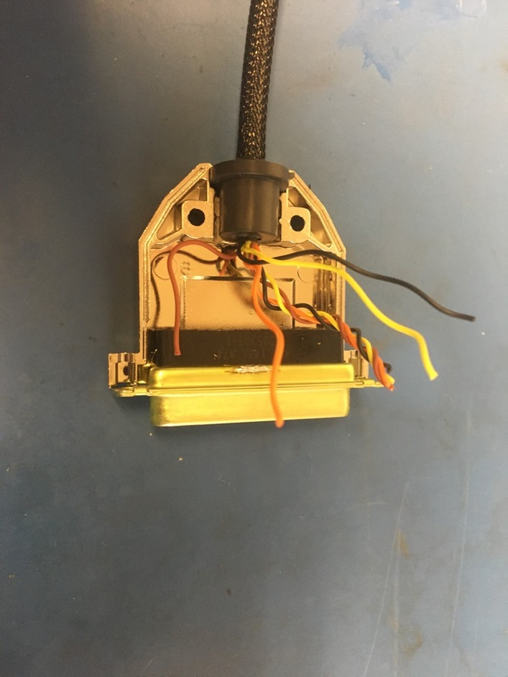
Position the brown wire as shown on the left and trim it so it ends midway through the black part of the connector.

Slide 29
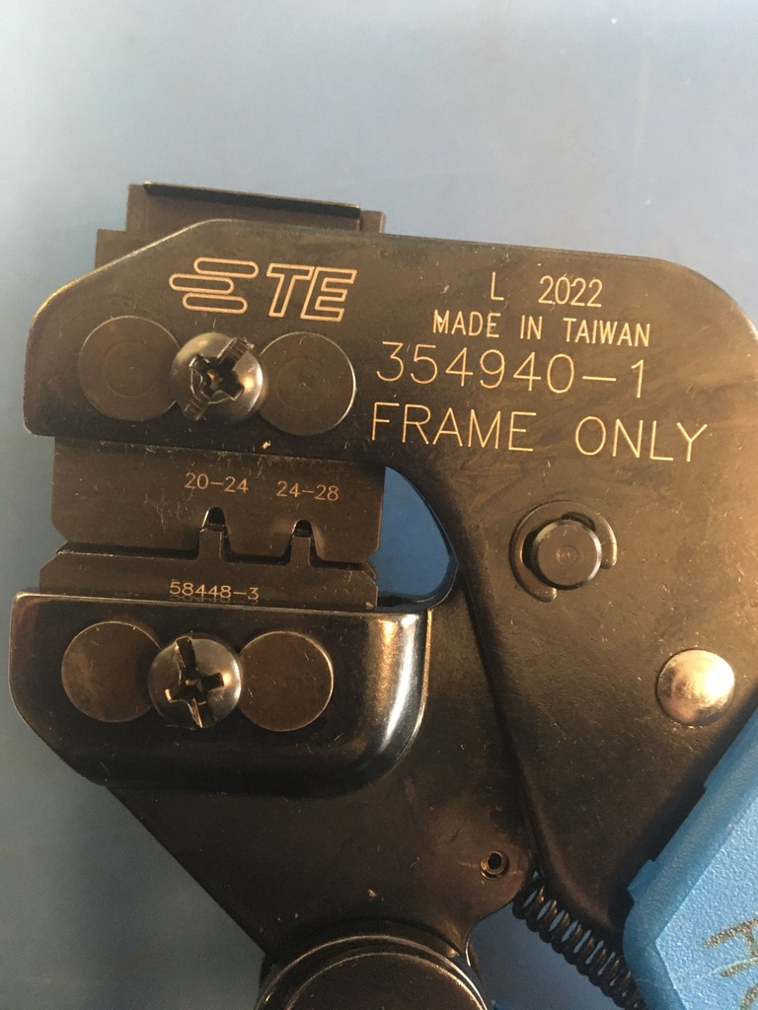
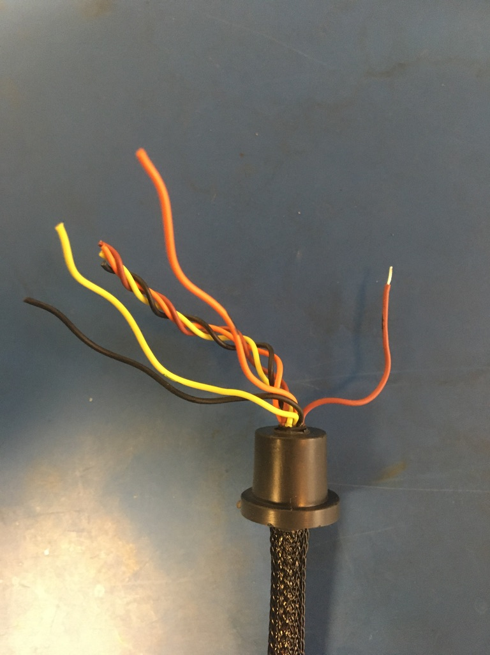
Strip about 2mm off the brown wire. Crimp one of the 24-28 awg pins onto the brown wire using the 24-28 awg setting on the D sub crimper.

Slide 30
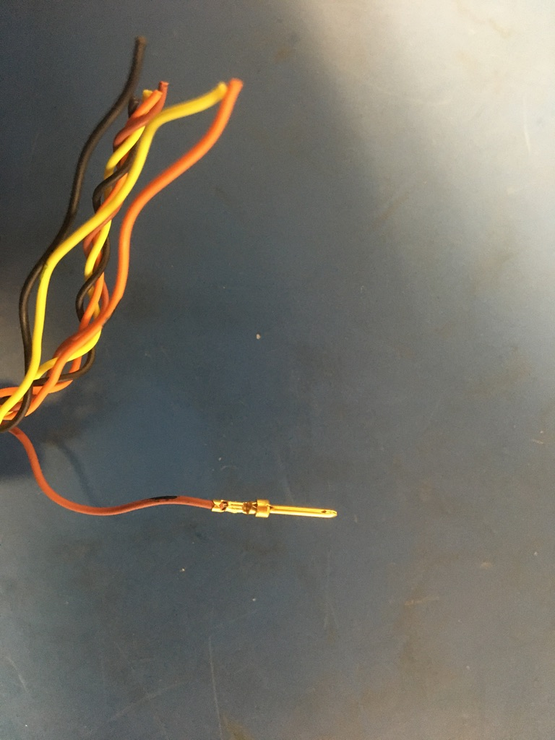
Once crimped the pin should appear as shown: the isolation held by the first grip but not the second and a bit of exposed wire should be peaking out of the top of the second grip.
Exposed wire just visible
Isolation in first grip

Slide 31
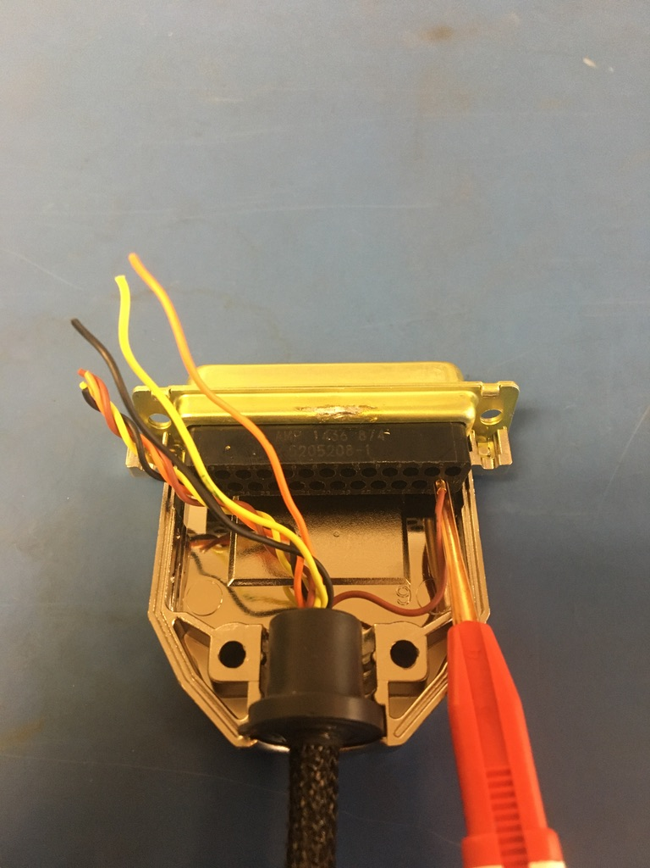
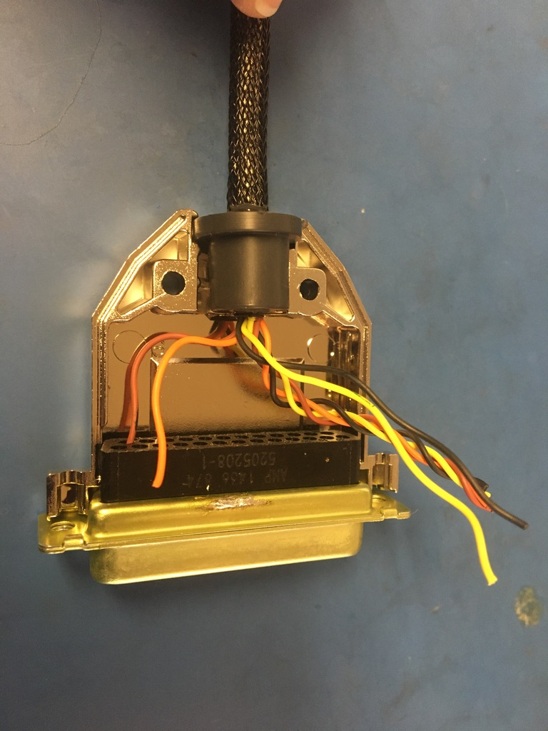
Insert the the brown wire using the red end of the D-sub insertion/extraction tool. The pin should feel to click once inserted all the way. Please reference the accompanying pin out document to see where each wire should go (the marked quadruple is the Y pole).

Slide 32
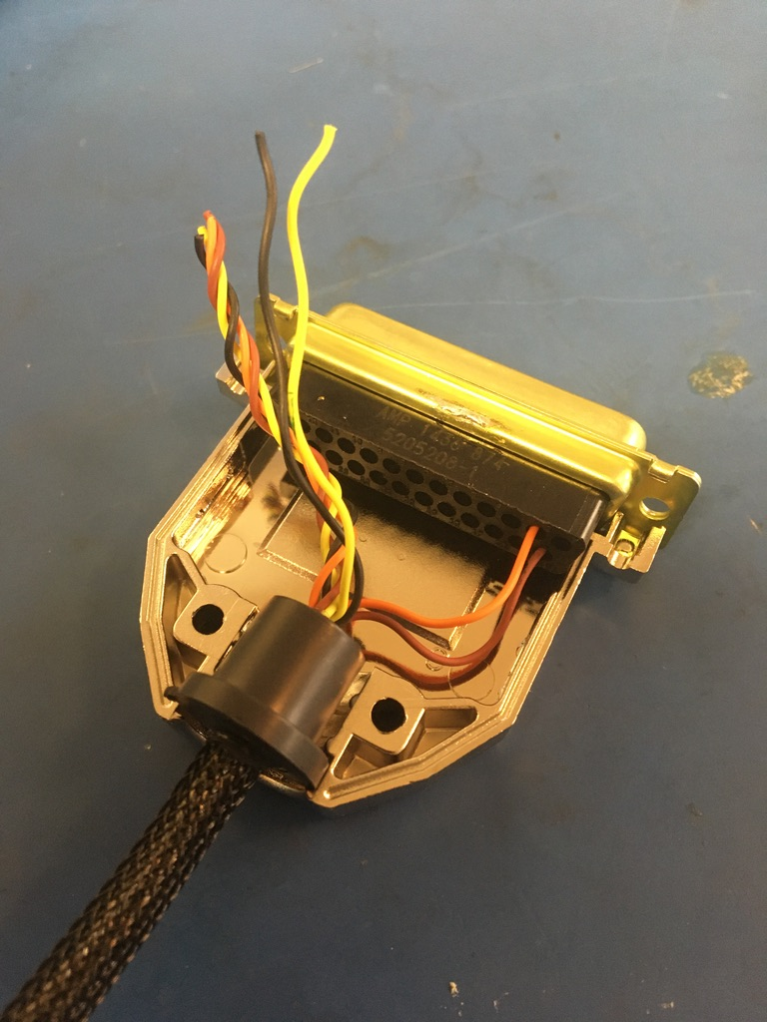
Measure, trim, strip, crimp, and insert the orange wire as previously exampled by the brown wire.

Slide 33
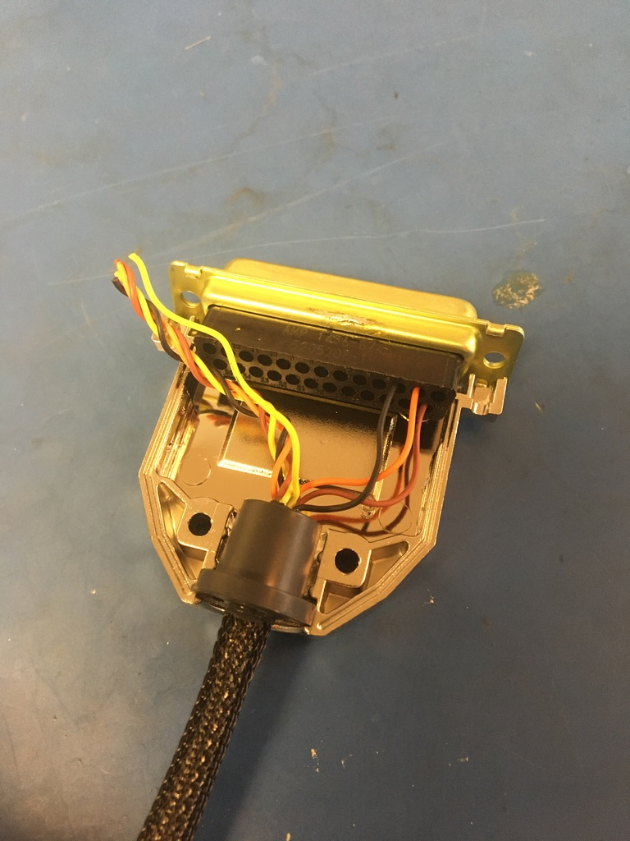
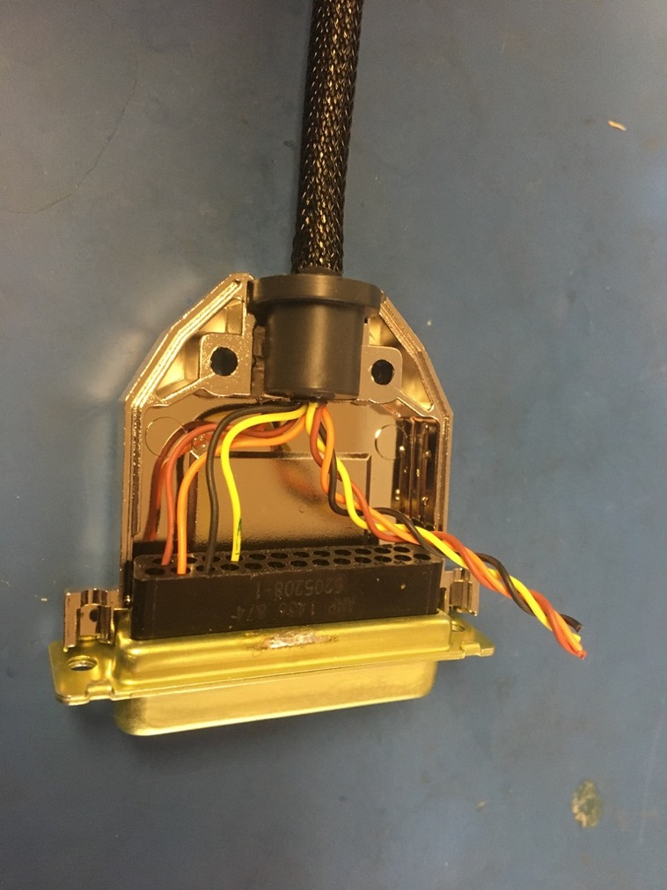
Measure, trim, strip, crimp, and insert the black and yellow wires.

Slide 34
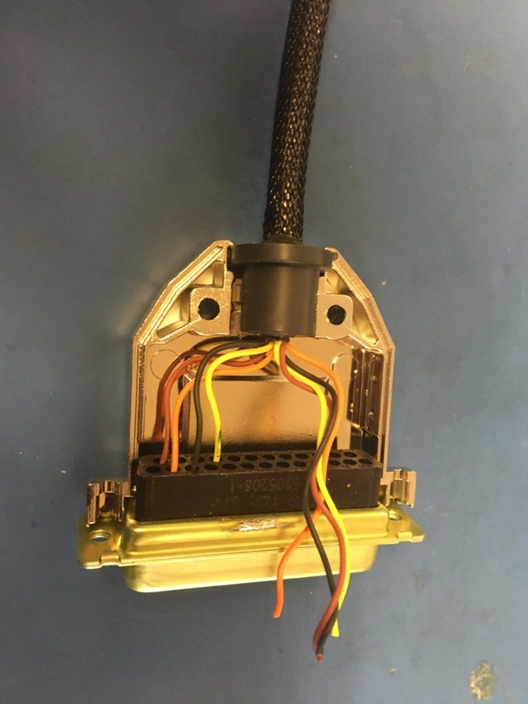

Untwist and straighten the second quadruple (the X pole). Measure, trim, strip, crimp, and insert each of wires from the second quadruple.

Slide 35



Place the top of the D-sub shell onto the bottom and put the connector screws and washers in. Close the D-sub shell using the screws and nuts. Part 3 of the wire harness complete.

Slide 36

Collect the three parts of the wire harness. Each of the three have an end without a connector. From that end, remove the shrink tube for the plastic braid off of each.

Slide 37

Measure out and cut one length of 12.7mm adhesive shrink tube that is 1in long.

Slide 38


Take the connector-less ends of the three parts and put them into the piece of shrink tube. The piece of shrink tube should be placed such that it ends where the metal braid shrink tube joints end next to the twisted wires. Apply the heat gun.

Slide 39


Place the triple shrink tube joint into the base of the 15 pin D sub shell. About .5in should be sticking out the back of the shell. Screw on the top of shell to ensure that triple shrink tube joint fits.

Slide 40


Take off the top of shell and put the 15 pin female D-sub connector into the bottom of the shell. Again, mark the Y pole quadruple closer to the base of the wire before the existing marking it cut off. Measure out and cut the twisted pairs so that they end at the mouth of the connector.

Slide 41

As for the previous connector, each wire needs to be measured, trimmed, stripped, and crimped before inserting it into the connector. For all of the wires, use the 24-28 awg setting on the D sub crimper and the FEMALE 24-28 awg pins. Again, please reference the accompanying pin out document to see the position of each wire. Be sure that the X and Y pole wires are not mixed up.

Slide 42

Untwist, measure, trim, strip, crimp, and insert the red and brown twisted pair.

Slide 43

Untwist, measure, trim, strip, crimp, and insert the orange and blue twisted pair.

Slide 44

Untwist, measure, trim, strip, crimp, and insert the green and yellow twisted pair.

Slide 45


Untwist, measure, trim, strip, crimp, and insert the Y pole quadruple.

Slide 46


Untwist, measure, trim, strip, crimp, and insert the X pole quadruple.

Slide 47

Replace the top of the D sub shell and screw it on.

Slide 48

Wire harness complete! The ground wires will be given tips later.

